Slide 1
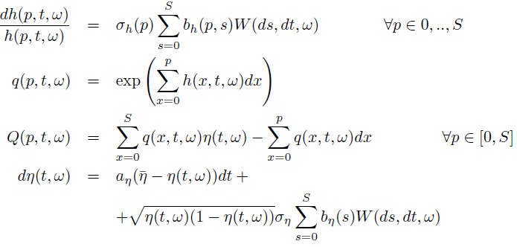
Modeling Framework:

Slide 2
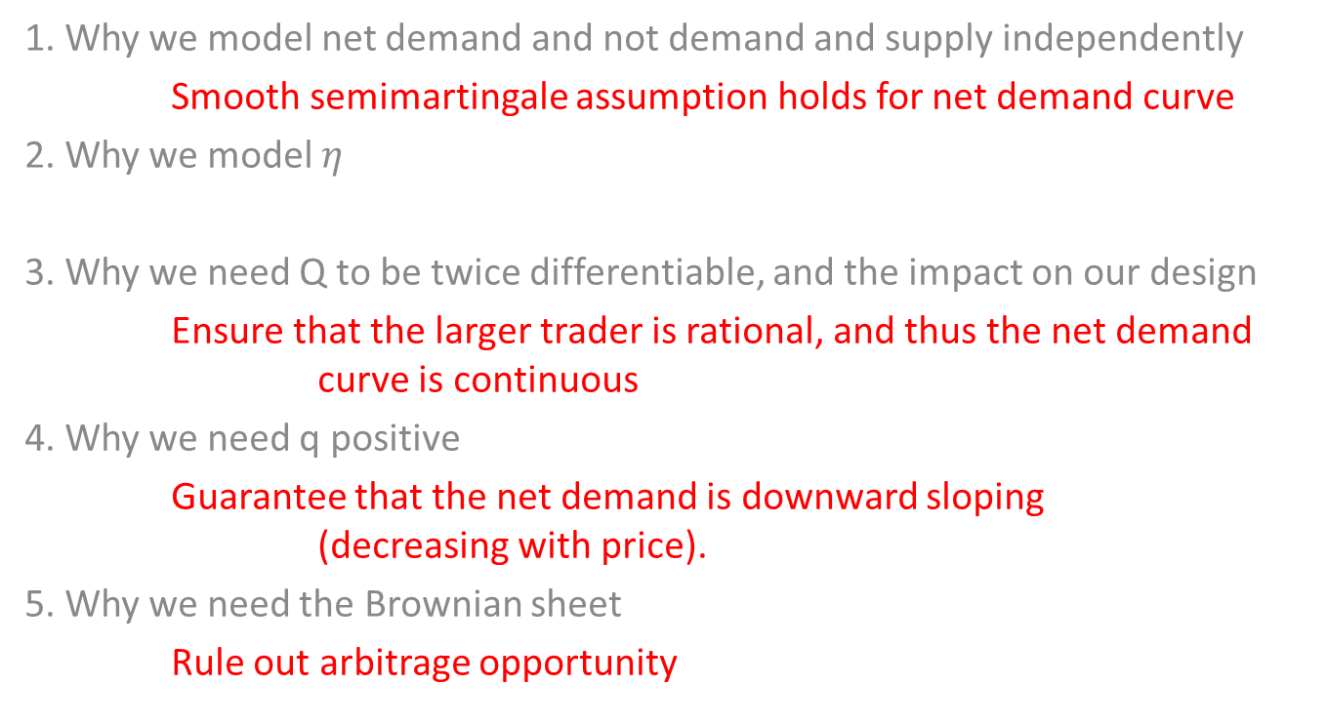
Modeling Challenges:
1. Why we model net demand and not demand and supply independently
Smooth semimartingale assumption holds for net demand curve
2. Why we model $η$
3. Why we need Q to be twice differentiable, and the impact on our design
Ensure that the larger trader is rational, and thus the net demand curve is continuous
4. Why we need q positive
Guarantee that the net demand is downward sloping (decreasing with price).
5. Why we need the Brownian sheet
Rule out arbitrage opportunity

Slide 3
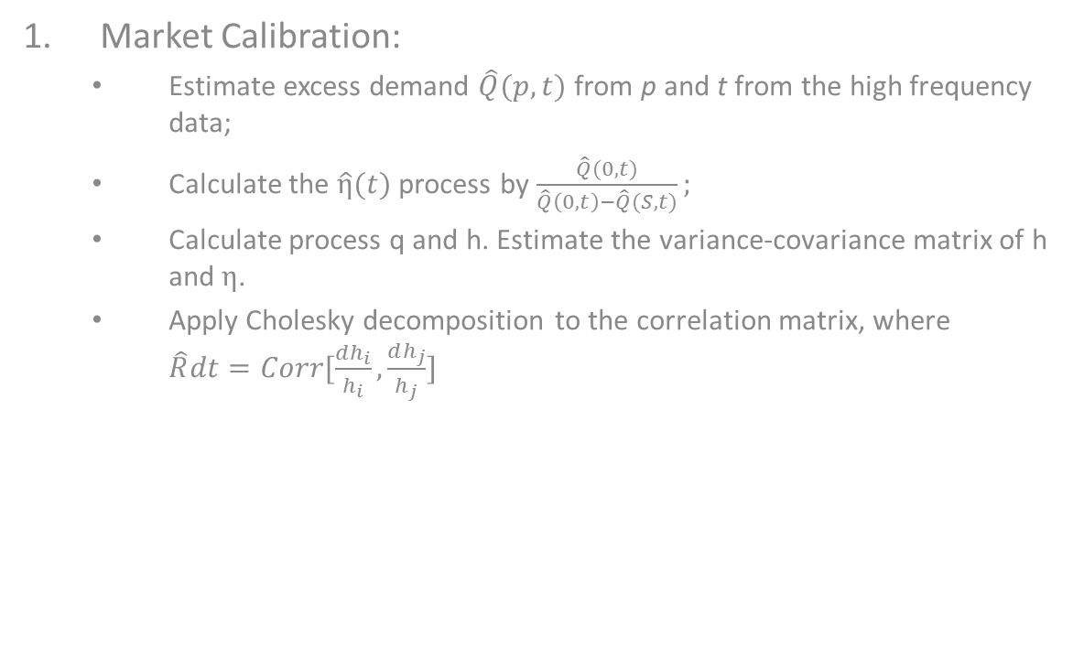
Simulation Process:
Market Calibration:
Estimate excess demand $\hat{Q}(p,t)$ from p and t from the high frequency data;
Calculate the $\hat{η}(t)$ process by $\frac{\hat{Q}(0,t)}{\hat{Q}\left(0,t\right)−\hat{Q}(S,t)};$
Calculate process q and h. Estimate the variance-covariance matrix of h and $η$.
Apply Cholesky decomposition to the correlation matrix, where $\hat{R}dt=Corr[\frac{dh_{i}}{h_{i}},\frac{dh_{j}}{h_{j}}]$

Slide 4
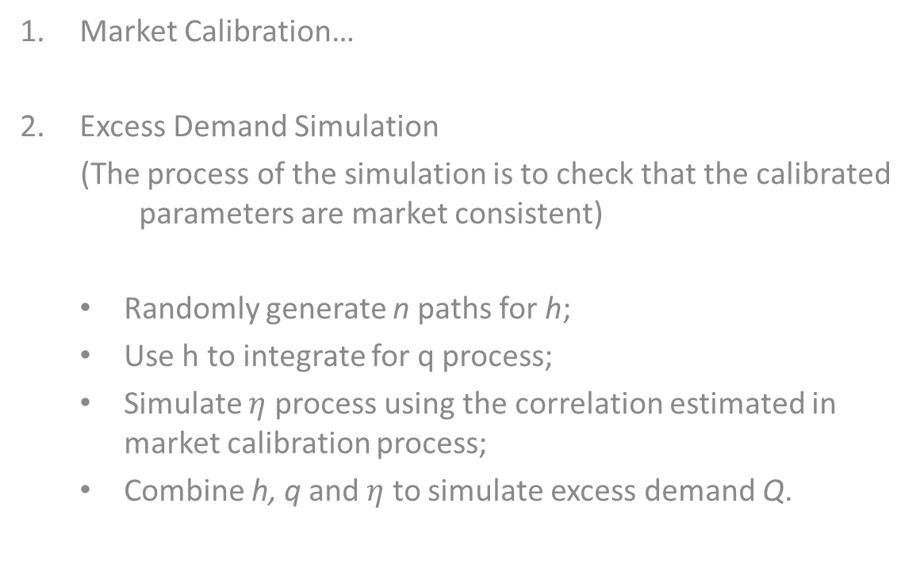
Simulation Process:
Market Calibration…
Excess Demand Simulation
(The process of the simulation is to check that the calibrated parameters are market consistent)
Randomly generate n paths for h;
Use h to integrate for q process;
Simulate $η$ process using the correlation estimated in market calibration process;
Combine h, q and $η$ to simulate excess demand Q.

Slide 5
Simulation Results:
AAPL as of 04-01-2011
Simulation results

